Slide 1
ANN and Deep Learning in Generative AI
AI, ANN, DL, Generative AI, Examples

Slide 2
Evolution of AI
AI
└── ML
└── ANN
└── DL
└── Generative AI
• ChatGPT
• Microsoft Copilot
• Gemini
• DALL·E

Slide 3
AI =AI is the broad concept of making machines perform tasks that normally require human intelligence. ML = ML is a subset of AI where computers learn from data instead of being explicitly programmed. ANN = ANN is a Machine Learning technique inspired by the human brain. Deep Learning = Deep Learning is an advanced ANN with many hidden layers.
Simple Comparison
AI | ML | ANN | DL
Makes machines intelligent | Learns from data | Brain-inspired ML model | ANN with many layers
Broadest concept | Subset of AI | Subset of ML | Subset of ANN
Chatbots | Recommendations | Pass/Fail Prediction | Face Recognition
Smart systems | Pattern learning | Few layers | Many layers

Slide 4
What is ANN?
Brain-inspired model with input, hidden and output layers.
Artificial Neural Networks (ANNs) are the fundamental building blocks of modern deep learning systems.
They consist of interconnected artificial neurons organized into layers that learn from training data to recognize patterns, make predictions and solve complex problems.
Organized into input, hidden and output layers
Learn by adjusting weights and biases during training
Process data through forward propagation and improve using backpropagation Support tasks such as classification, regression and prediction
Form the foundation of advanced deep learning architectures such as CNNs, RNNs and Transformer
Formula = Z=x1w1+x2w2+b

Slide 5
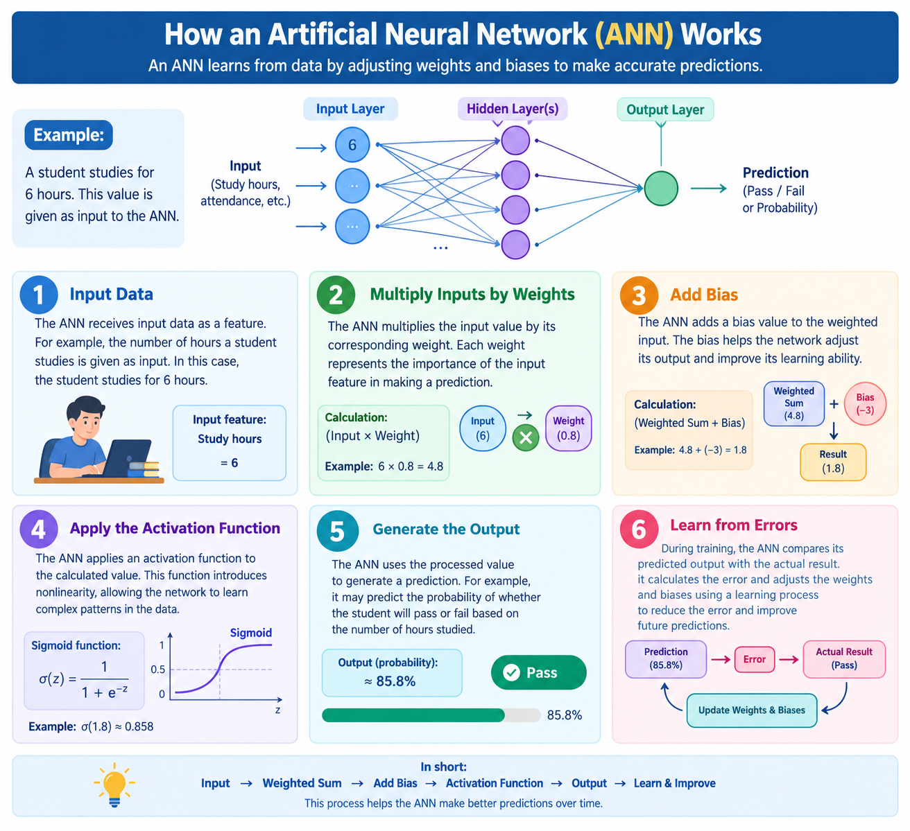

Slide 6
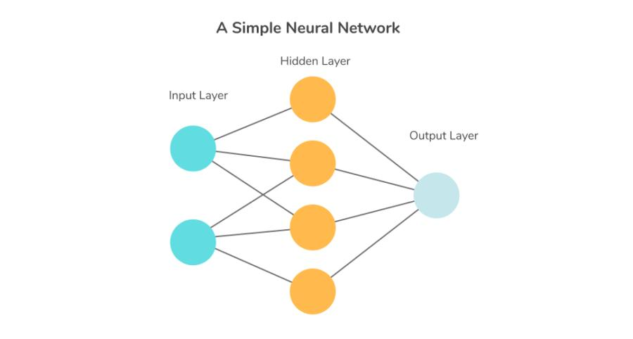
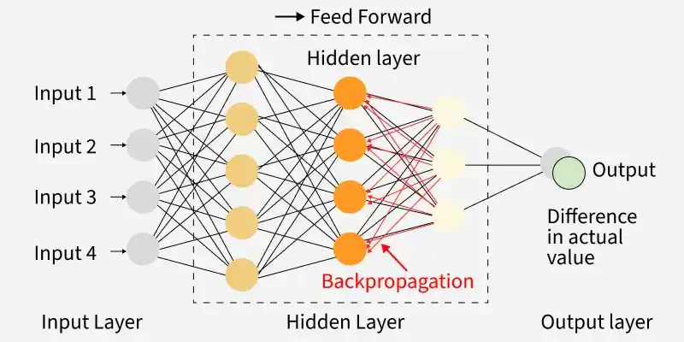

Slide 7
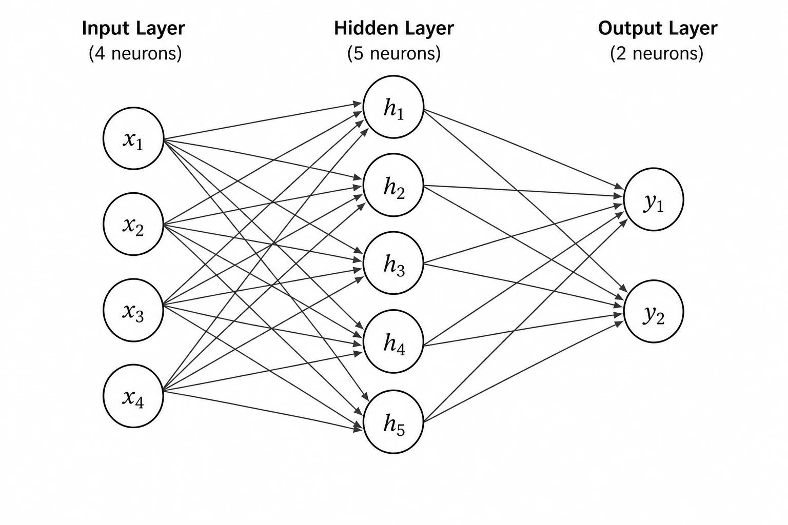
How ANN Works

Slide 8
Term | Meaning
ANN | Brain-inspired learning system
Neuron | Basic processing unit
Weight | Importance of input
Bias | Extra adjustment value
Activation Function | Decides neuron output
Forward Propagation | Data moves forward
Loss Function | Measures error
Backpropagation | Learns from mistakes
Epoch | One full training cycle
Learning Rate | Learning step size
Overfitting | Memorizing data
Underfitting | Not learning enough

Slide 9
How an Artificial Neural Network (ANN) Works:
Input Data:
The ANN receives input data as a feature. For example, the number of hours a student studies is given as input. In this case, the student studies for 6 hours.
2. Multiply Inputs by weights:
The ANN receives input data as a feature. The ANN multiplies the input value by its corresponding weight. Each weight represents the importance of the input feature in making a prediction.
3. Add Bias
The ANN adds a bias value to the weighted input. The bias helps the network adjust its output and improve its learning ability.
4. Apply the Activation Function: The ANN applies an activation function to the calculated value. This function introduces nonlinearity, allowing the network to learn complex patterns in the data.
5. Generate the Output: The ANN uses the processed value to generate a prediction. For example, it may predict the probability of whether the student will pass or fail based on the number of hours studied.
6. Learn from Errors: During training, the ANN compares its predicted output with the actual result. It calculates the error and adjusts the weights and biases using a learning process to reduce the error and improve future predictions.

Slide 10
ANN Analogy: Curd Preparation
Milk + Starter + Temperature + Time → Processing → Curd
ANN Architecture:
Step 1: Identify the Inputs
Input 1 → Milk Quality
Input 2 → Temperature
Input 3 → Starter Culture Quantity
Input 4 → Fermentation Time

Slide 11
\
For Example:
Milk Quality = Fresh
Temperature = 32°C
Starter = 2 spoons
Time = 8 hours
Step 2: ANN Receives Inputs
Milk Quality ──────┐
Temperature ───────┼──► ANN
Starter Culture ───┤
Time ──────────────┘
Step 3: Hidden Layer Learns Patterns
Hidden Layer
● ● ● ●
/|\ /|\ /|\ /|\

Slide 12
The hidden layer learns patterns such as:
Is the temperature suitable?
Is the milk fresh?
Is there enough starter culture?
Has enough time passed?
Milk Quality ──────┐
│
Temperature ───────┼────► Hidden Layer
│ ● ● ● ●
Starter Culture ───┤
│
Fermentation Time ─┘
│
▼
Good Curd
or
Bad Curd

Slide 13
Advantages | Disadvantages
Learns automatically from data | Needs large datasets
Handles complex problems | Training can be slow
High prediction accuracy | High computational cost
Works with noisy data | Difficult to interpret results
Adaptable and flexible | Can overfit training data
Supports parallel processing | Requires parameter tuning
Real-World Applications
Face Recognition
Spam Detection
Stock Market Prediction
Medical Diagnosis
Voice Assistants

Slide 14
What is Deep Learning?
Deep Learning (DL) is a branch of Machine Learning that uses Artificial Neural Networks (ANNs) with many hidden layers to learn patterns from large amounts of data.It is called "deep" because the neural network contains multiple layers between the input and the output

Slide 15
TYPES OF DL
Deep Learning Types ANN │ ├─ Tabular Data │ CNN ├─ Images │ RNN ├─ Sequential Data │ LSTM ├─ Long-Term Memory │ Autoencoder ├─ Compression │ GAN ├─ Image Generation │ Transformer └─ Generative AI

Slide 16
Pros of Deep Learning | Cons of Deep Learning
🎯 High Accuracy | 💾 Needs Large Data
🤖 Automatic Learning | 💻 Expensive Hardware
🖼️ Works with Images, Text & Audio | ⏳ Long Training Time
🚀 Powers ChatGPT & Copilot | 🔍 Hard to Explain Decisions
📈 Improves with More Data | ⚠️ Overfitting Risk

Slide 17
1. What is an Artificial Neural Network (ANN)?
2. What is Deep Learning?
3. What is the difference between ANN and Deep Learning?
4. What are the main components of an ANN?
5. What is a neuron in ANN?
6. What are weights and biases?
7. What is an activation function?
8. Why is ReLU widely used?

Slide 18


